Slide 1
Recommending Missing Sensor Values
Chung-Yi Li∗ , Wei-Lun Su∗ , Todd G. McKenzie∗ , Fu-Chun Hsu∗ , Shou-De Lin∗ , Jane Yung-jen Hsu∗ , Phillip B. Gibbons†
∗ National Taiwan University
† Carnegie Mellon University

Slide 2
Missing Data Estimation
Motivation
Wireless Sensor Network
data loss in communication, external interference, power depletion, hardware failure,
EX: Intel Berkeley Research lab dataset 50% missing
Most data analysis tools can’t handle missing data
Goal:
Perform missing data estimation for centralized analysis
Applicable to all time series data

Slide 3
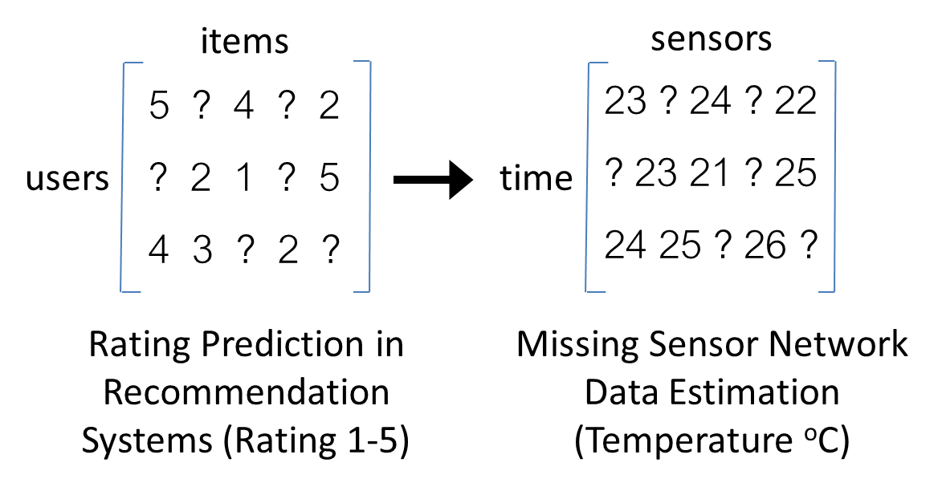
Relation to Collaborative Filtering
Main difference:
# columns VS # rows ratio
Temporal correlation
Spatial correlation
Heterogeneous sensors

Slide 4
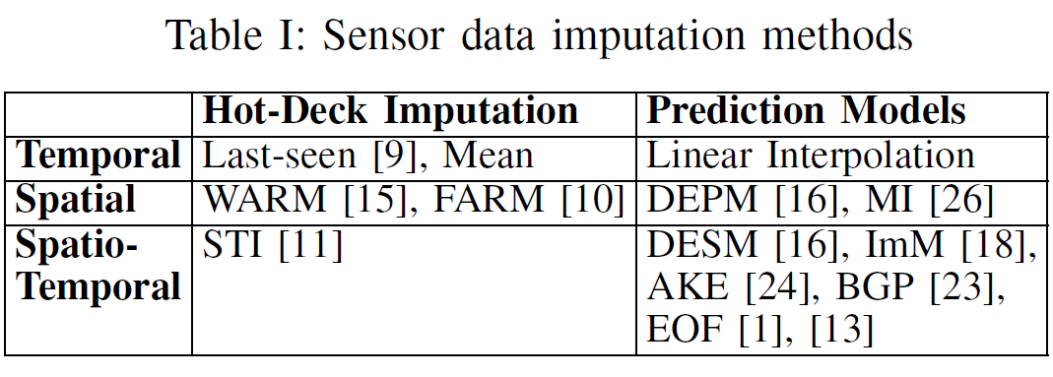
Existing approaches

Slide 5
Empirical Orthogonal Functions (EOF)
Matrix Decomposition Models
Assumption: the matrix is low rank
Algorithm
Fill in missing values (e.g. zeros or means)
Perform SVD (X = UDV^{T}) and obtain k-rank approximation
Refine the missing data estimation and repeat the process
1.04 | 2.09 | 2.91
2.09 | 4.18 | 5.83
0.39 | 0.78 | 1.09
1 | 2 | 3
2 | 4 | 6
1 | 2 | ?
1 | 2 | 3
2 | 4 | 6
1 | 2 | 0
U D V^{T}
1
2
U₁ D₁ V₁^{T}
3
1 | 2 | 3
2 | 4 | 6
1 | 2 | 1.09
Notes:
maybe briefly talk about improved version of EOF

Slide 6
Disadvantage of EOF
Dense matrix slows down the computation process
imperfect initial imputation significantly hurts the final imputation result

Slide 7
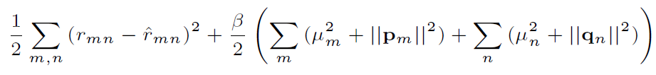


Matrix Factorization
Arguably the most successful CF model
Do the factorization directly on observed entries
MF with bias terms
p_{m}: hidden factors of a time step
q_{n}: hidden factors of a sensor
$$R≈PQ$$

Slide 8
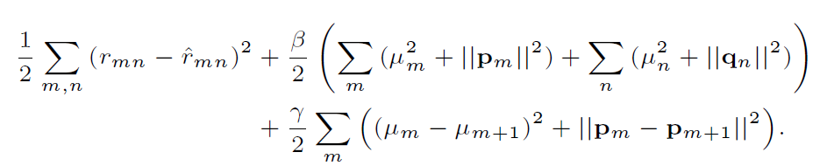
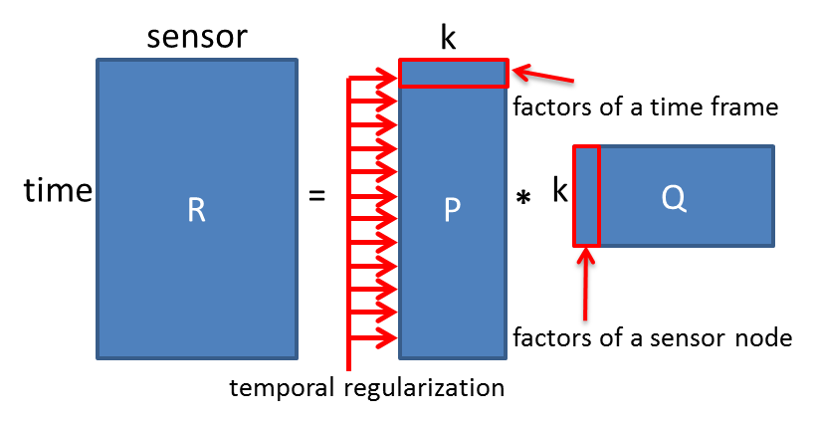
Temporal Regularized Matrix Factorization (TR-MF)

Slide 9
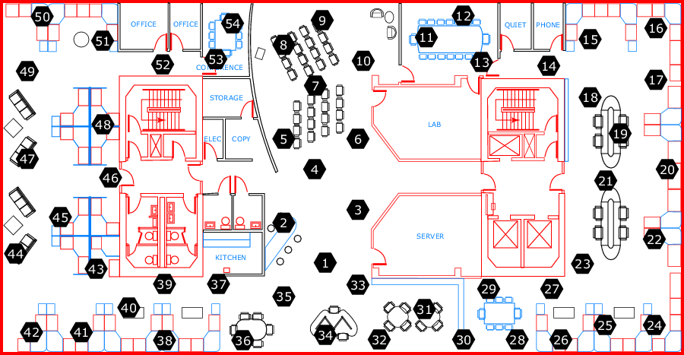
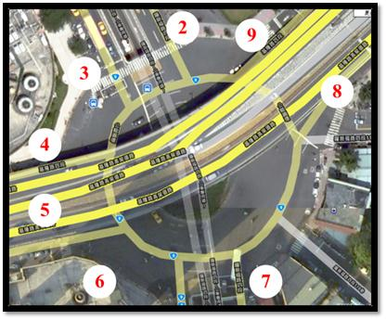
Experiment Datasets
Intel Berkeley Research Lab
Indoors
Temperature, humidity, light
5000 time steps, 54 sensor nodes
Sampling Rate: 30 sec
Inherent missing: 49%
Trafﬁc Dataset
Outdoors
Temperature, humidity
43K time steps, 20 sensor nodes + gateway
Sampling rate: 30 min
Inherent missing: 58%

Slide 10
Experiment Setup
Missing Data Generation
Random missing
Consecutive missing
x%, 10%, (90-x)% = train, validation, test set ratio

Slide 11
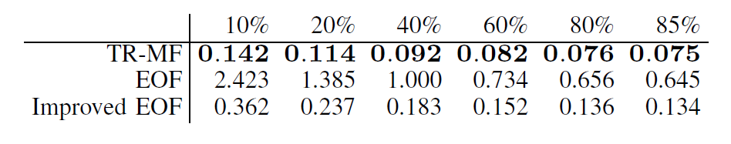
Compared with EOF
Root mean square error with different training set ratio

Slide 12
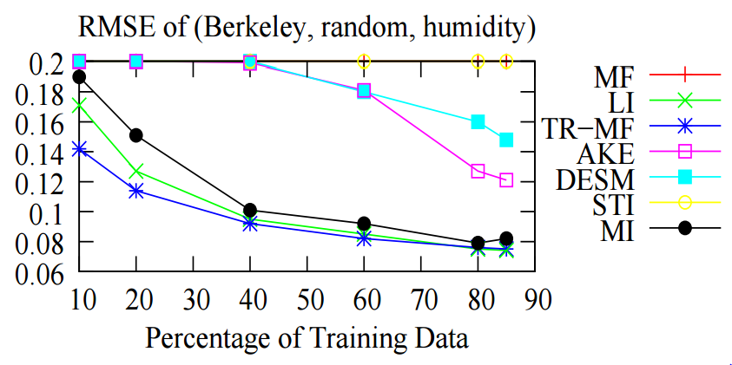
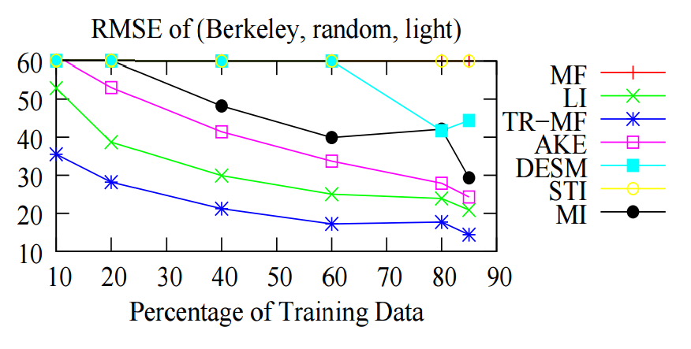
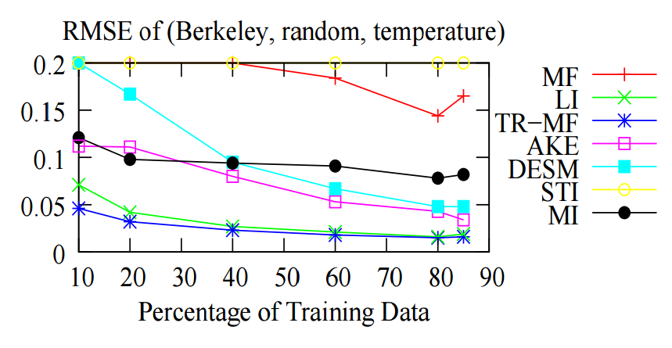
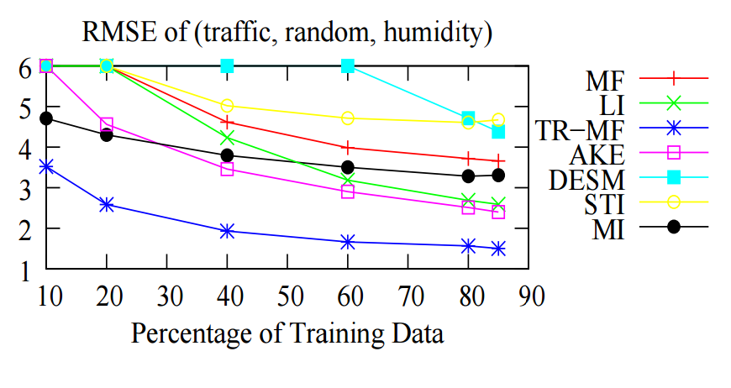
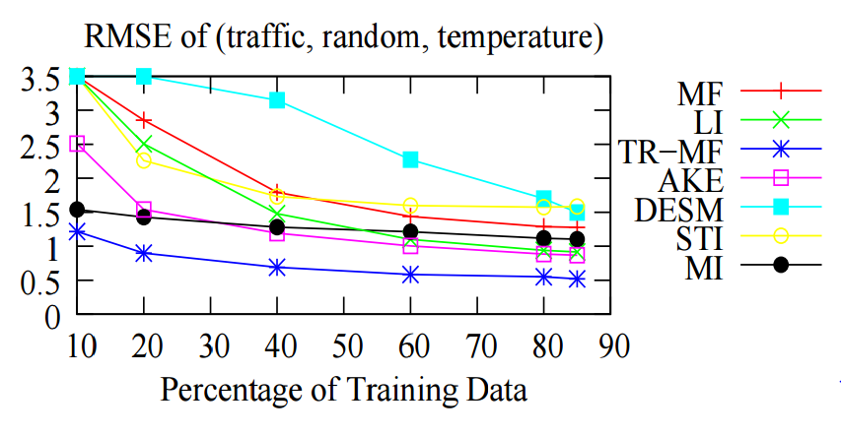
Experiment: random missing
TR-MF is the best
power of temporal correlation:
MF
Linear interpolation
Notes:
Compare with other models.
Look at blue line!
The lower the better (RMSE)

Slide 13
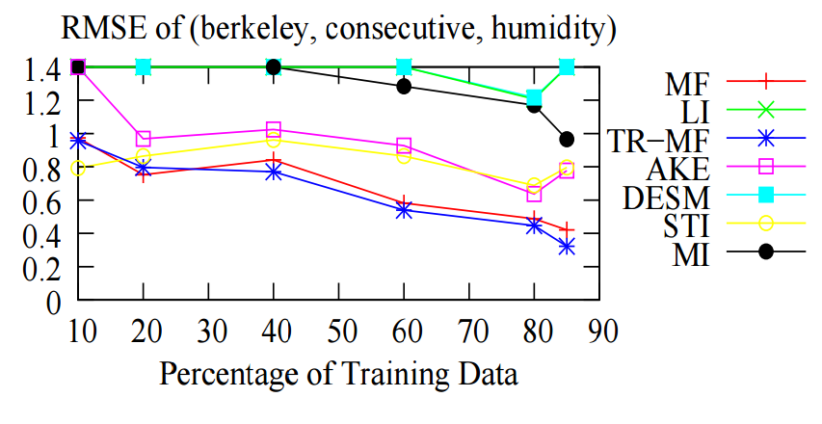
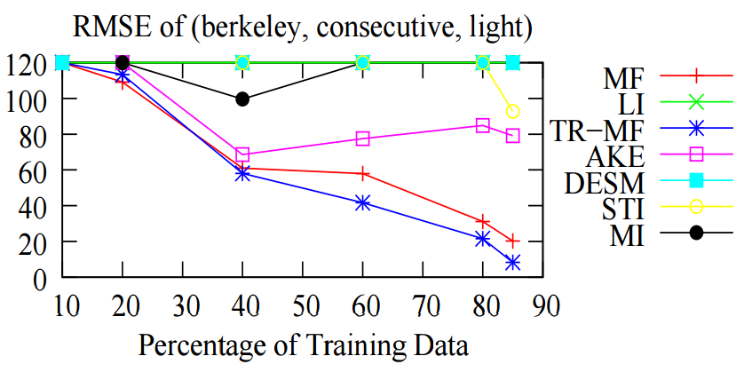
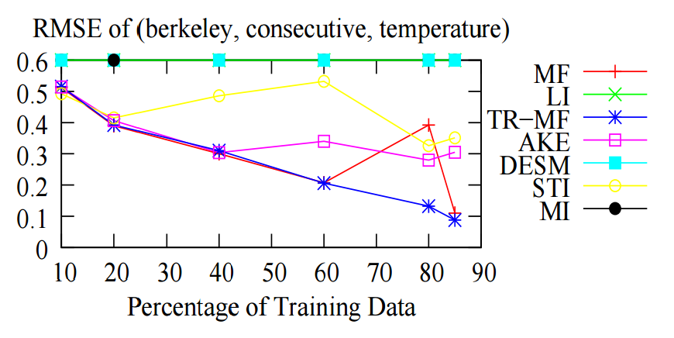
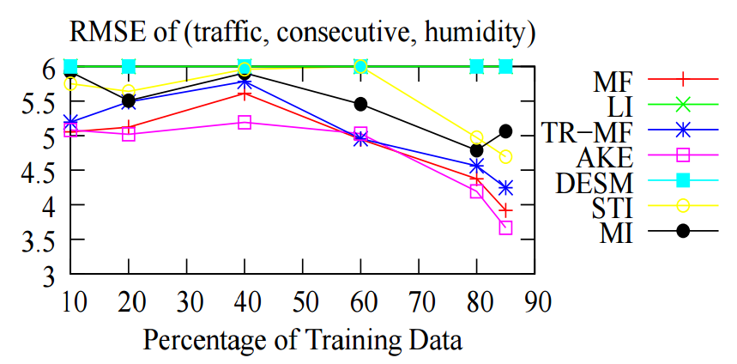
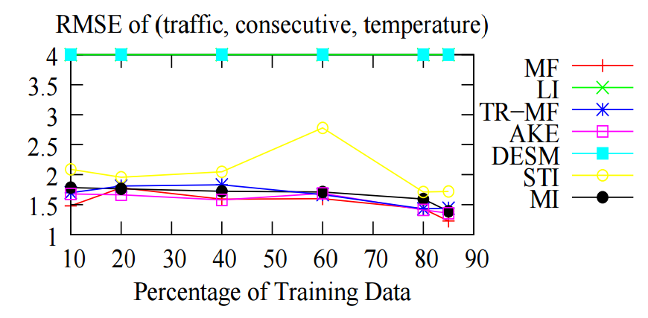
Experiment: consecutive missing
TR-MF becomes similar to MF
Temporal correlation is not applicable
Still outperforms most models

Slide 14
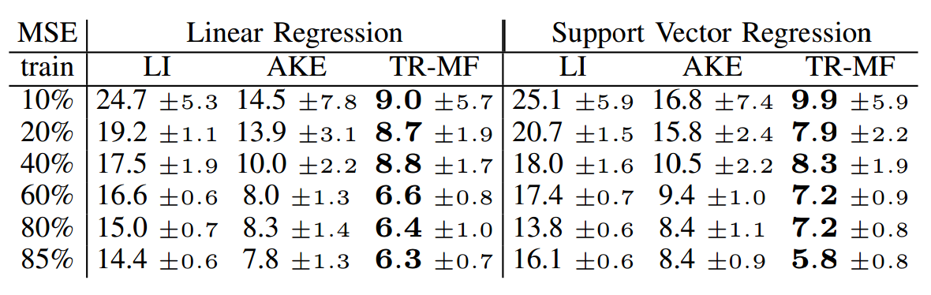
Further Prediction
Better missing data estimation leads to better prediction model
ﬁll in all the missing humidity values in the remaining 20 sensors
predict the temperature values of the gateway
Notes:
Again, this is error rate. The lower the better

Slide 15
Heterogeneous information: MTR-MF Model
Multivariate TR-MF
Simple concatenation of two matrices
Independent scaling, two bias terms in a row
$$R=\left[R_{tem} R_{hum}\right]$$

Slide 16
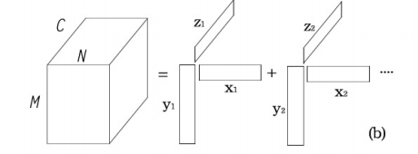
Heterogeneous Information: TR-TF Model
Temporally-Regularized Tensor Factorization (TR-TF)
Humidity Tensor
M: Sensor nodes
N: Time steps
C: discretization of
temperature
Both models are solved by stochastic gradient descent

Slide 17
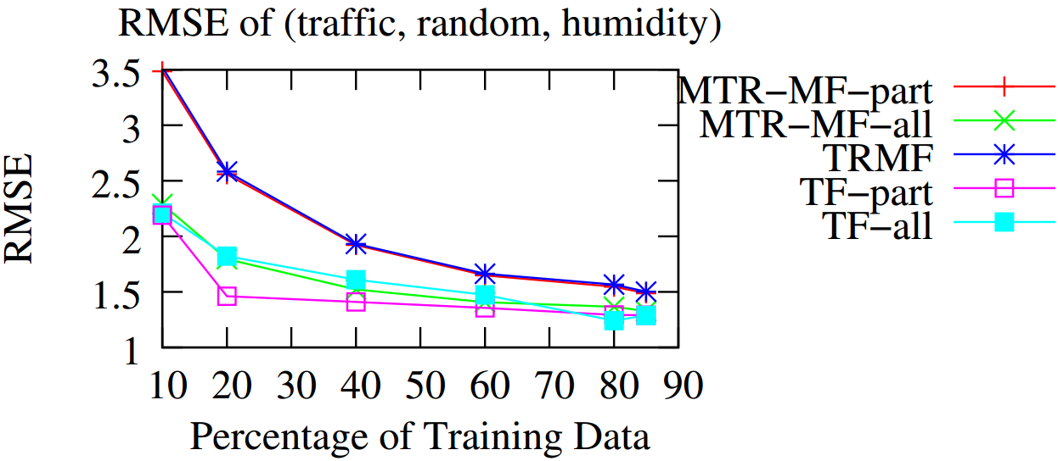
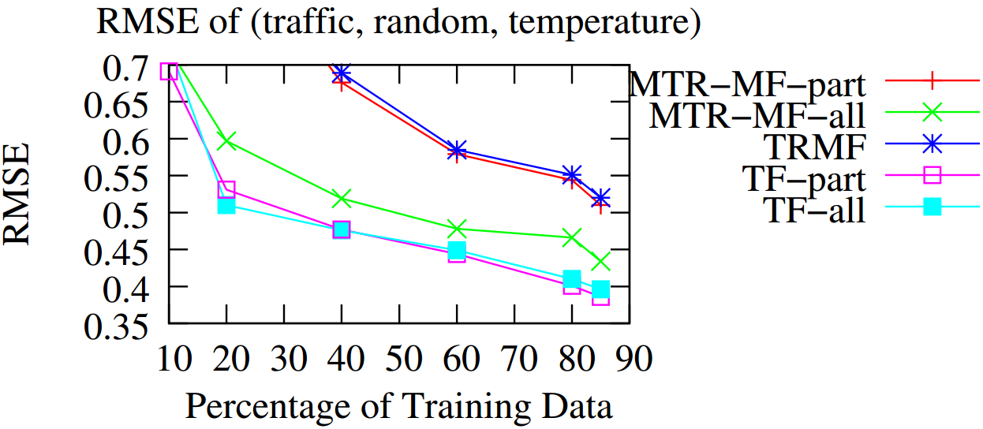
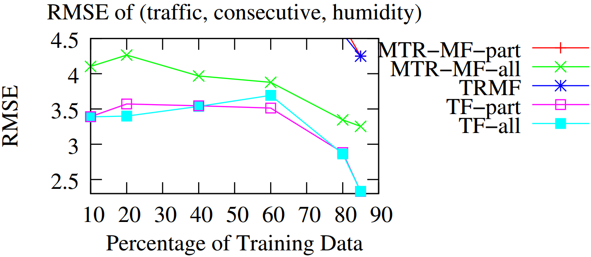
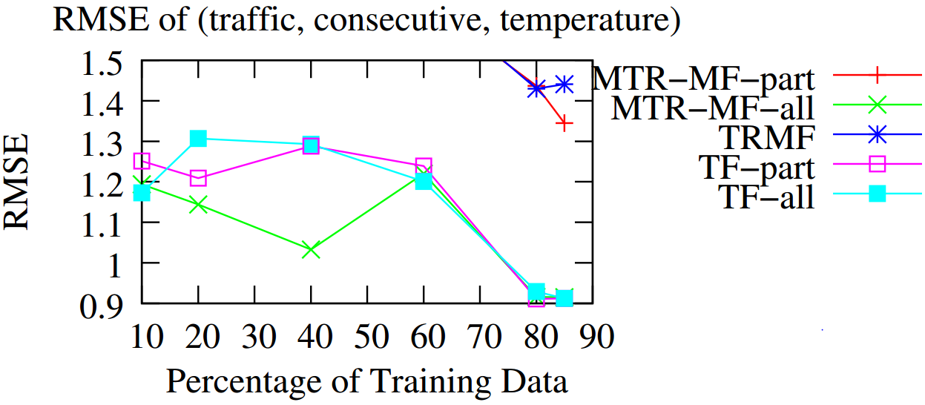
Heterogeneous Information: Experiment
Notes:
Scenario : predict humidity reading
All : training on hum_train + tem_train + tem_valid + tem_test
Part :
training on hum_train + tem_train

Slide 18
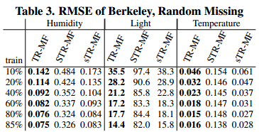
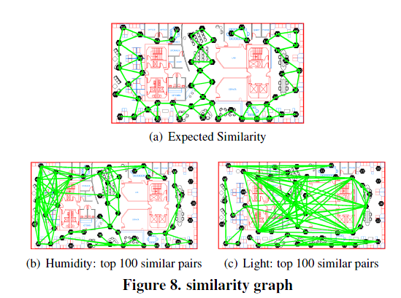
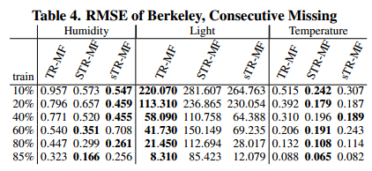
Spatial Regularization
Spatial regularization is applicable when
Inadequate information in Data
Human assumption is correct
Notes:
May skip if no time

Slide 19
Conclusion
Adapt the matrix factorization from recommendation systems to WSN
TR-MF gives the best performance
Random missing
Consecutive missing
Further prediction
Extension
Heterogeneous information
Spatial Regularization

